Slide 1
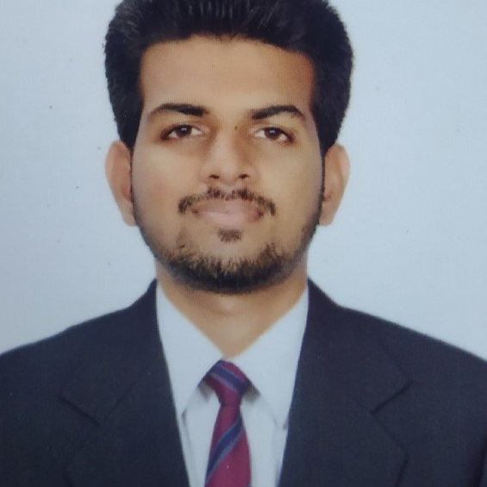


Prasid Satish Chinchankar
Analyst/Software Engineer
Bachelor of Engineering
Computer Science: 2017 - 2021
Skills
Mumbai
C# | C# Basics, OOPS, Generics, Collections, Arrays, Loops,Data Types in C#;
ASP .NET | ASP .Net Fundamentals, Entity Framework Web API Routing Web API Introduction.
ASP .NET Core | Building an API with .Net Core, Dependency Injection in ASP.Net Core.
UI Framework-React | React ,Java Script, React getting started,Fundamental and Routing ,CRUD Operation with BackEnd -Web API.
React | Components, Services, Modules, Routing, Forms & Validation, Testing using Jasmin & Karma
Database | MSSQL Server,basics of SQL
UI Tech | HTML 5 & CSS 3,JavaScript, Optimized UI Designed
Tools | Swagger, Postman, IDE.
Add On skills | Communications, Team management. Peer learning
prasid-satish.chinchankar@capgemini.com
+91 8861663186
A4
Basic Understanding in creating Web Application with ASP.NET , .NET Core, Web API, React.
Hands on experience in developing web pages using HTML5, CSS3, Object Oriented Programming
Practical understanding of rendering ASP.NET Web Forms, MVC Razor, REST API.
Implemented Web API and React in case study and up skilling this knowledge continuously.
Basic understanding on API testing, Selenium testing.
Hands on experience on MultiBrowser testing.
Ecommerce Shopping Cart Application
Working on end to end case study of Ecommerce Shopping Cart Application along with authentication, Swagger and React used for user interface.
.NET and React for web developers in Degreed Platform
Completed this course with optimal Knowledge of MVC ,Web API , RESTful services , Components.
AZURE CERTIFICATION
Has successfully completed the requirement to be recognized as Microsoft Certified : Azure Fundamentals
Check out my work on GitHub & Video Profile

